Slide 1
HOW TO VIEW AND PAY THE eBILL
Student Accounts

Slide 2
PAYING FOR COLLEGE: A UB TIMELINE
June
July
August
HUB Student Center To-Do list items
Consider payment options + resources
Review SUNY Smart Track Financial Aid Plan
Submit additional applications (TAP, Excelsior, loans)
Grant access for supporter(s) via FERPA or Authorized Payer
Enroll in Payment Plan
Review eBill (sent July 22)
Verify all financial aid shows on eBill
Pay eBill (due August 21)
Send HS and college transcript(s) to UB (August 26)

Slide 3
BEFORE CLASSES BEGIN
First eBill sent July 22 (via email)
Verify all financial aid shows on eBill
Grant Authorized Payer access
Payment Plan enrollment opens July 15
Entire July 22 eBill due August 21

Slide 4
eBill NOTIFICATION
On July 22,
eBill notification is sent to student’s UB email address.
Paper bills are NOT mailed.
From: UBeBill@buffalo.edu <UBeBill@buffalo.edu> Subject: Your University at Buffalo eBill is available online
Name: Victor E. Bull
ID #: 512345678
Invoice Amount: $ 396.75*
Your University at Buffalo electronic billing statement (eBill) is now available. You are receiving this notification due to potential new activity on your account such as charges, payments, refunds or Financial Aid activity. Any unpaid charges from the previous eBill will be brought forward, and additional charges, payments and credits will be shown. Paper bill statements are not being mailed to students. The payment due date and amount due can be found on your eBill. Anticipated aid is being used to reduce the amount due.
Your eBill reflects account activity as of 7/22/2024, the invoice date. Subsequent activity will not show on your eBill.
To view your eBill, current account activity or to make a payment:
Log into your HUB Student Center through myub.buffalo.edu.
In your Student Center, click on Billing / Payments tile.
You will then be brought into QuikPAY.
Click on View & Pay Accounts
A guide explaining how to read your student bill is available on the following website: buffalo.edu/studentaccounts/billing/access-and-read-your-bill

Slide 5
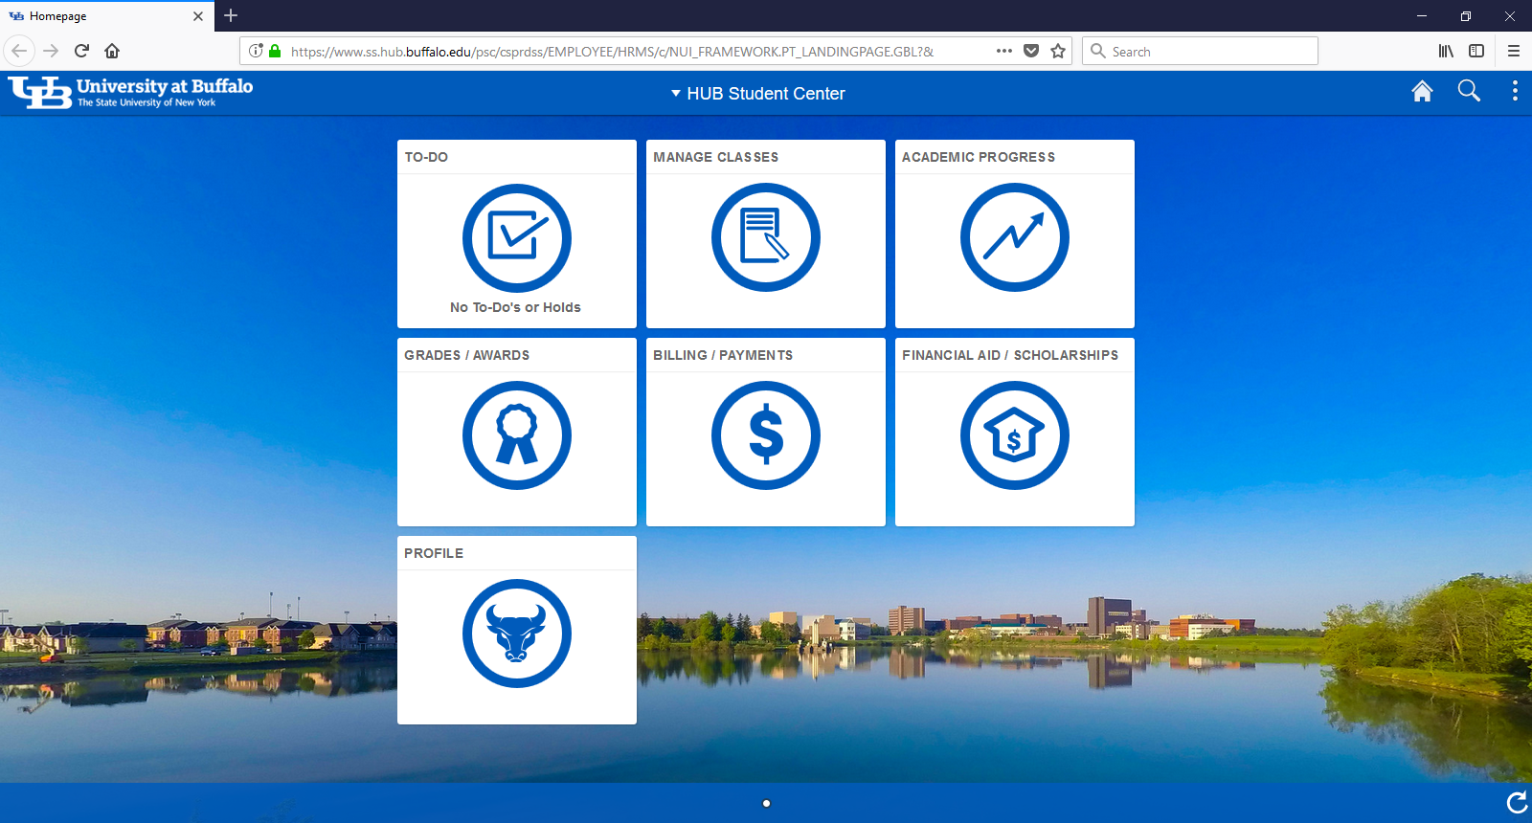
HUB STUDENT CENTER
Okay, how
do I find my eBill?

Slide 6
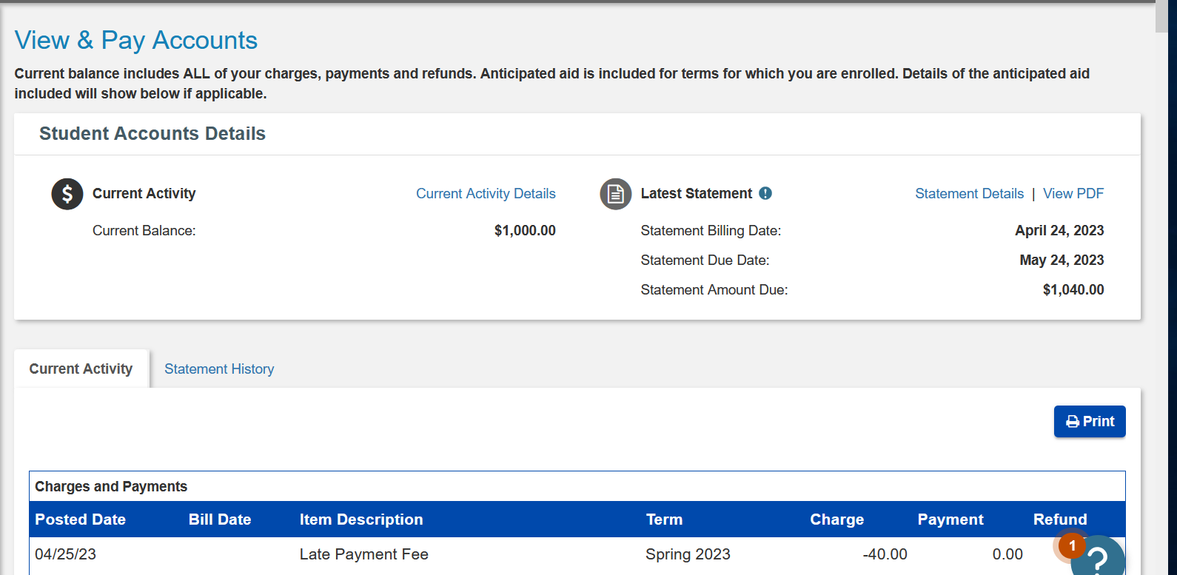
QUIKPAY – VIEW + PRINT YOUR eBill
eBill due
August 21
$ 361.90
$ 361.90

Slide 7
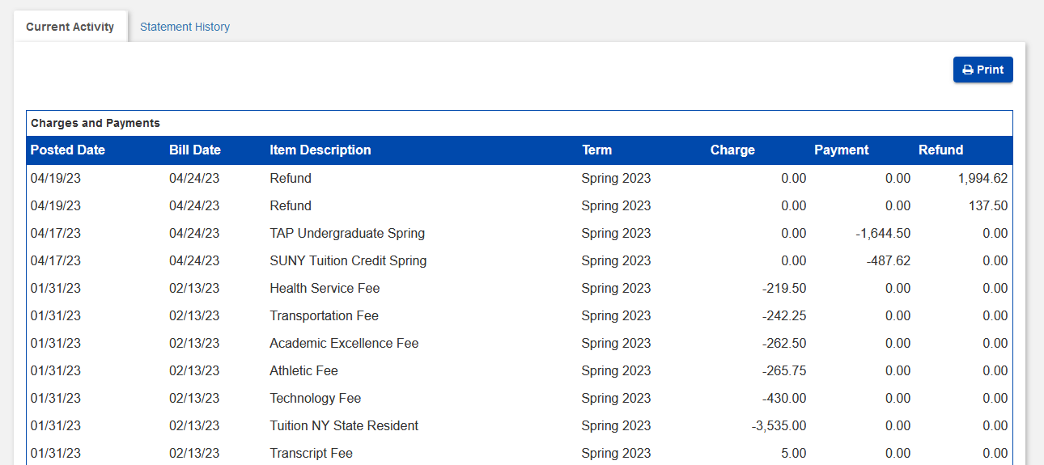
QUIKPAY – CURRENT ACTIVITY
Current
Activity
updates
nightly

Slide 8
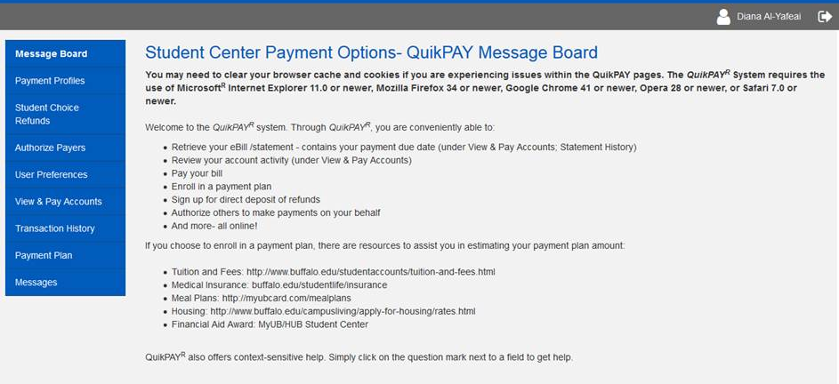
QUIKPAY – AUTHORIZED PAYER ACCESS
Students can give access
to spouse or family member to view and pay eBill.

Slide 9
WHAT TO EXPECT ON YOUR eBill
CHARGES
Tuition (charge for actual credit hours registered); classes added on/after July 22 will appear on September 9 eBill
Mandatory and broad-based fees
Class fees
Meal plan
Campus housing
Note: Billing is
for one semester/term, not the full academic year.

Slide 10
WHAT TO EXPECT ON YOUR eBill
PAYMENTS AND ANTICIPATED FINANCIAL AID
Tuition and housing deposits will be deducted
Anticipated aid will be deducted to calculate amount due
Must complete To-Do List items for aid to show on eBill
If aid is canceled due to ineligibly, might result in a balance
If missing expected aid on your eBill, contact Financial Aid
Pay the amount due by due date to
avoid late payment fees.
Do not wait for a revised bill.
Holds will be placed on unpaid bills
after 60 days from bill date.

Slide 11
HUB STUDENT CENTER

Slide 12
HOW TO PAY YOUR eBill
ONLINE PAYMENTS
eCheck from your personal bank account; please note your daily max limit.
Credit Card (MasterCard, Visa, Discover, American Express)
Can only be made online
Spouse/family need Authorized Payer access
No convenience fee
MAIL
Personal / 529 Checks
University at Buffalo
PO Box 10068
Albany, NY 12201-5068
Scholarship Checks
University at Buffalo
1 Campus Mail Center
Buffalo, NY 14260

Slide 13
QUIKPAY – HOW TO MAKE A ONE-TIME PAYMENT
$ 361.90
$ 361.90
This is the only way to pay with a credit card.
If you are enrolled in a payment plan, do not use “Make a Payment” button.

Slide 14
HOW TO PAY YOUR eBill
PAYMENT PLAN
Pay the eBill in installments by enrolling in a Payment Plan.
How? Enroll online
When?
For 5 installments, enroll July 15 - Aug. 14
For 4 installments, enroll Aug. 15 - Sept. 14
For 3 installments, enroll Sept.15 - Sept. 27
Plan Details
$45 non-refundable enrollment fee
Offered fall and spring terms only
Interest-free; not a loan program
Provide payment account when you enroll; can change account as often as you’d like
Installments automatically taken out on payment due date
On a payment plan, you’ll receive email reminders about upcoming payments and changes in installment amount.

Slide 15
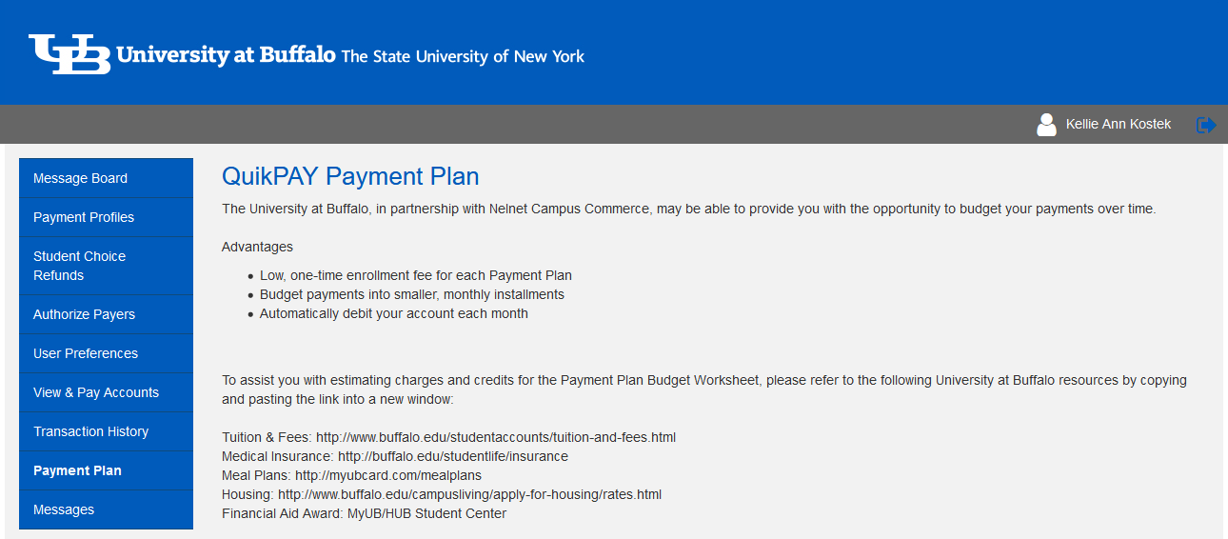
QUIKPAY – ENROLL IN PAYMENT PLAN
Fall 2024 Payment Plan enrollment begins
July 15
Last day to enroll is
September 27

Slide 16
WHEN DOES AID DISBURSE?
PELL
SEOG
Direct Subsidized Loans
Direct Unsubsidized Loans
Parent PLUS
Alternative/Private Loans
UB Scholarships
TAP
SUNY TUITION CREDIT
NYS Merit Scholarships
NYS Excelsior Scholarship, Excelsior Tuition Credit and NYS STEM funds
will not disburse until after final grades are received each term.
Disburses 1 week before the start of classes.
Disburses after the fifth week (100% tuition liability) of semester.
Notes:
Disbursement is the process of releasing financial aid and posting the funds directly to your student account.
Federal aid, which includes the Pell grant, SEOG, Subsidized and Unsubsidized loans, Parent loans and Private loans will disburse the week before classes start. As well as your UB scholarship. State aid, such as TAP and SUNY Tuition Credit, or if you receive other NYS merit scholarships, will disburse after 100% tuition liability, which is after the 5th week of the semester. After reviewing your academic standing and we determine you meet those requirements, your NYS aid will continue to show as pending on your e-Bill until the actual funds disburse.
Regarding Excelsior and NYS STEM, those funds will not get released until after grades are in for each term. The funds will show as an estimate and as pending until it is determined you are academically eligible for those funds. It’s important to read about those academic requirements and also work with your academic advisor to ensure you are taking the degree applicable credit hours for those funds.
It’s typically after NYS aid disburses when students do receive their refund (if they qualify for TAP or other NYS Merit Scholarships). If you don’t qualify for NYS aid, then after federal aid disburses and there is more aid than what is needed, then the Student Accounts office will process a refund.

Slide 17
QUIKPAY – ENROLL IN DIRECT DEPOSIT
Students Receiving a Refund
Refund is available to you much faster – within 48 business hours
Safeguard against lost or stolen checks

Slide 18
SEMESTER BILLING CYCLE
Review every statement for new charges as all charges might not appear on first eBill.
July 22 eBill includes tuition and fees for classes added on or before July 21 (due August 21)
September 9 eBill includes tuition and fees for classes added after July 22 (due October 9)
October 14 eBill (due November 13)
November 18 eBill (due December 18)
View future billing dates at buffalo.edu/studentaccounts/billing

Slide 19
How to contact
Student Accounts
In Person: 1Capen, North Campus
1Diefendorf, South Campus
By phone: 716-645-1800
Complete the Contact Us Form or chat with Virtual Vic 24/7:
buffalo.edu/studentaccounts

